Slide 1
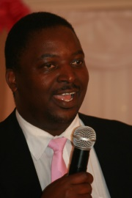
Zambia Society for Public Administration Public Lecture, 16 June 2016 The African Leadership Challenge and the distorted bearings of faith! A Tsunami of a Crisis! But what is the solution?
Dr Ernest Kadembo, Professor of Business; PhD, MBA, MSc, HBS, PGCE, Cert. Case Writing, Cert. E-Mod
www.inspiredtrans.com ekadembo@yahoo.com ernestk@inspiredtrans.com

Slide 2
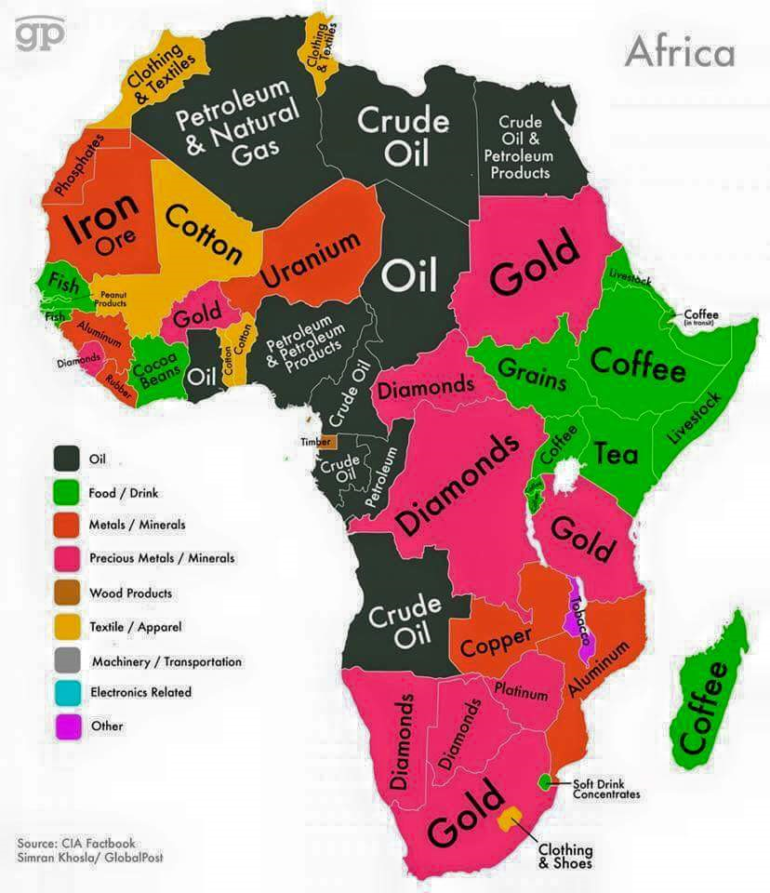
Africa Resource Endowment

Slide 3
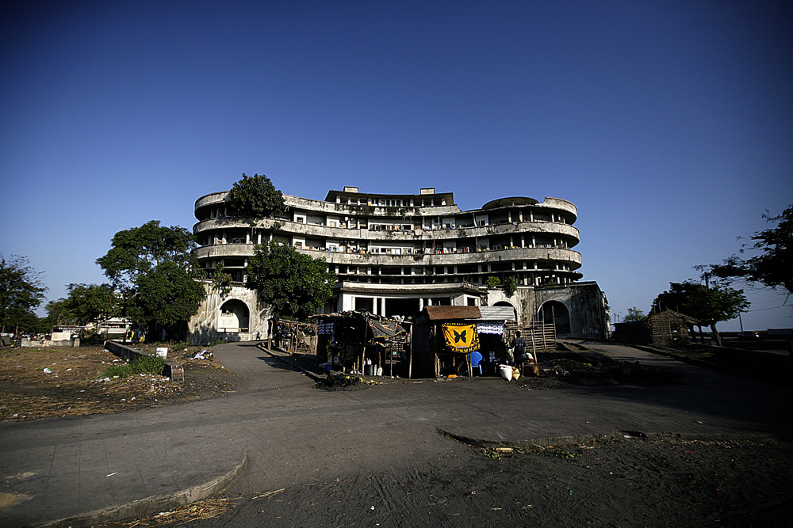
The Depict Grande Hotel Beira
Notes:
The hotel was built in 1955, at one point the best hotel in Africa, but now a squater haven.

Slide 4
Chilling Statistics
50% of Africa’s population lives on less than $1.25 per day. 1 million Africans die of malaria each year and 85% of the victims are not even 5 years old.

