Slide 1
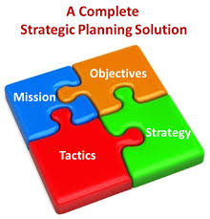
Strategic leadership and management For Sustainable Development
Presented at Zambian Society for Public Administration International Conference, Lusaka, 17/06/ 2016
Dr Stella Kyohairwe
stella.kyohairwe@gmail.com; skyohairwe@umi.ac.ug

Slide 2
Key words
Leadership,
Management
Strategy
Strategic management

Slide 3
LEADERSHIP

Slide 4
Leadership is…
A process by which a person influences others to accomplish an objective and directs the organization in a way that makes it more cohesive and coherent (Northouse, 2007).
“the behavior of an individual… directing the activities of a group toward a shared goal”. (Hemphill & Coons, 1957)

Slide 5
leading is about setting direction and ensuring that, that direction is followed.
Common catchwords in the definition
providing direction; and
exercising influence

Slide 6
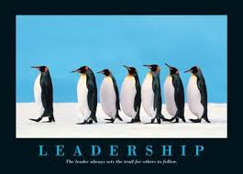
Leadership is…

Slide 7
Or see Leadership as...

Slide 8
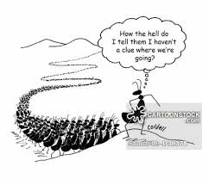
When Leadership goes wrong!

Slide 10
What is Management?
It is the art of making people more effective than they would have been without you: and the science of how to do it
It is working with and through people
Management basic functions:
planning , budgeting, organizing, directing, Coordinating, supervising

Slide 11
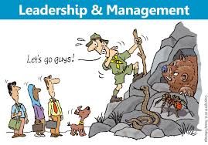

Slide 12
Look at strategy as:
A method or a plan chosen to bring about a desired future, such as achievement of a goal, or solution to a problem.

Slide 13
Strategy…
Strategies are the initiatives a company takes to maximize its resources and to grow its business.
This involves financial planning, and human resources
are in line with organization vision and mission.

Slide 14
What is Strategic Leadership &Management?
strategic management is about driving the company's growth through effective management techniques with a focus on setting and achieving organizational goals .

Slide 15
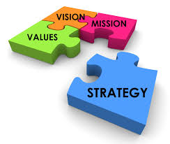
Strategic management requires

Slide 16
A strategic management involves
A systematic analysis of the factors associated with:
customers and competitors (the external environment) and
the organization itself (the internal environment) to provide the basis for maintaining optimum management practices.

Slide 17
External environment are..
Conditions, entities, events and factors surrounding an organization that influence its activities and choices, and determine its opportunities and risks.
It is also known as Operating environment

Slide 18
Internal environment
These are conditions, entities, events, and factors within an organization that influence its activities and choices particularly the behavior of the employees
Comprises of Factors like:
the organization’s Mission
Leadership Styles
Organizational culture

Slide 19
What managers & leaders must Know
That not every issue or decision is strategic
That some decisions strategic issues while other are operational issues

Slide 20
What Characterizes Strategic decisions?
They give a Long term direction of the organization
They determine the scope of the organization activities- size and activities
They give a competitive advantage of the organization over others

Slide 21
What Characterises Strategic decisions?
Ensure a Strategic fit of the business and its environment – e.g focusing on market needs
Exploits the capability of Organizational Resources and competences
Put into consideration Values and expectations of key actors in and around the organisation

Slide 22
Implications of ineffective strategic decisions
Complexity of the organization in terms of structure, products or services
Uncertainty of the organization, the people within and environment future
Non-allignment with Operational decisions
irregular Relationships and networks outside the organisation
challeges in implementing Change

Slide 23
Levels of a strategy
Corporate level strategy – concerned with overall scope of the organization
Focus: Geographical coverage, business units, diversity of products, business units/departments, resource allocation

Slide 24
Levels…
Business level Strategy- focusing on competition in the market environment –
Focus is on Pricing, innovation and differentiation

Slide 25
Levels…
Operational level- focus on coordination f different parts of the organization for effective delivery
The concern issues include
Resources
Processes
people

Slide 26
Overall leadership & Management question
How do your strategies fit in the national Plans and goals?
What strategies does your organization have for Sustainable Development Goals (SDGs) 2030?

Slide 27
SDGs 1-17
End poverty in all its forms everywhere
End hunger, achieve food security and improved nutrition and promote sustainable agriculture
Ensure healthy lives and promote well-being for all
Ensure inclusive and equitable quality education and promote lifelong learning opportunities for all
Achieve gender equality and empower all women and girls
Ensure access to water and sanitation for all
Ensure access to affordable, reliable, sustainable and modern energy for all
Promote inclusive and sustainable economic growth, employment and decent work for all
Build resilient infrastructure, promote sustainable industrialization and foster innovation
Reduce inequality within and among countries

Slide 28
SDGs…
Make cities inclusive, safe, resilient and sustainable
Ensure sustainable consumption and production patterns
Take urgent action to combat climate change and its impacts
Conserve and sustainably use the oceans, seas and marine resources
Sustainably manage forests, combat desertification, halt and reverse land degradation, halt biodiversity loss
Promote just, peaceful and inclusive societies
Revitalize the global partnership for sustainable development

Slide 29
For your attention, I say…

