Slide 1
How IT Could Inspire the Causes of Sustainable Development
June 2016

Slide 2
Presentation Flow
Sustainable Development
Pillars of Sustainable Development
Sustainable Development Goals (SDG)
How IT Can Inspire SDG
Recommended Way Forward

Slide 3
Sustainable Development
It is a process for meeting human development goals while sustaining the ability of natural systems to continue to provide the natural resources and ecosystem services upon which the economy and society depend
It is the kind of development that meets the needs of the present without compromising the ability of future generations to meet their own needs

Slide 4
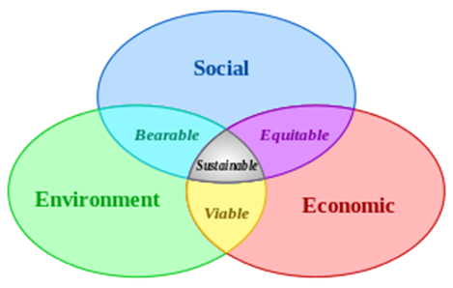
Pillars of Sustainable Development
Economic growth, Environmental protection & Social equality

Slide 5
Economic Growth
Most groups focus on this pillar when attempting to attain more sustainable efforts and development.
In trying to build their economies, many countries focus their efforts on resource extraction, which leads to unsustainable efforts for environmental protection as well as economic growth sustainability
The total worldwide consumption of resources is projected to increase in the future. So much of the natural world has already been converted into human use that the focus cannot simply remain on economic growth and omit the ever growing problem of environmental sustainability
So we have to focus on ways to generate economic growth without hurting the environment.

Slide 6
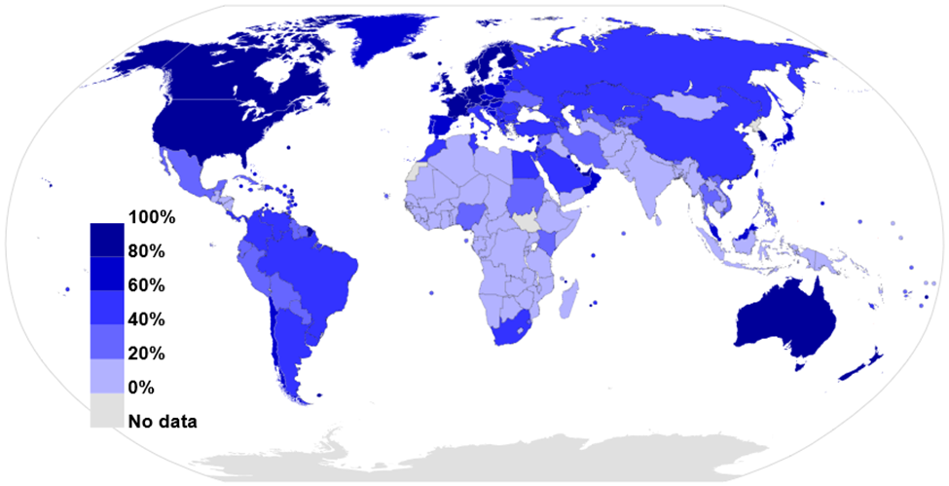
Economic Growth
Technology is an indicator for economic growth. Think of any developed state in the world, what is at the core of it is technology, especially ICT. the greatest number of Internet users in Africa resides in either South Africa and Kenya in the sub region or in Nigeria, Morocco and Egypt.

Slide 7
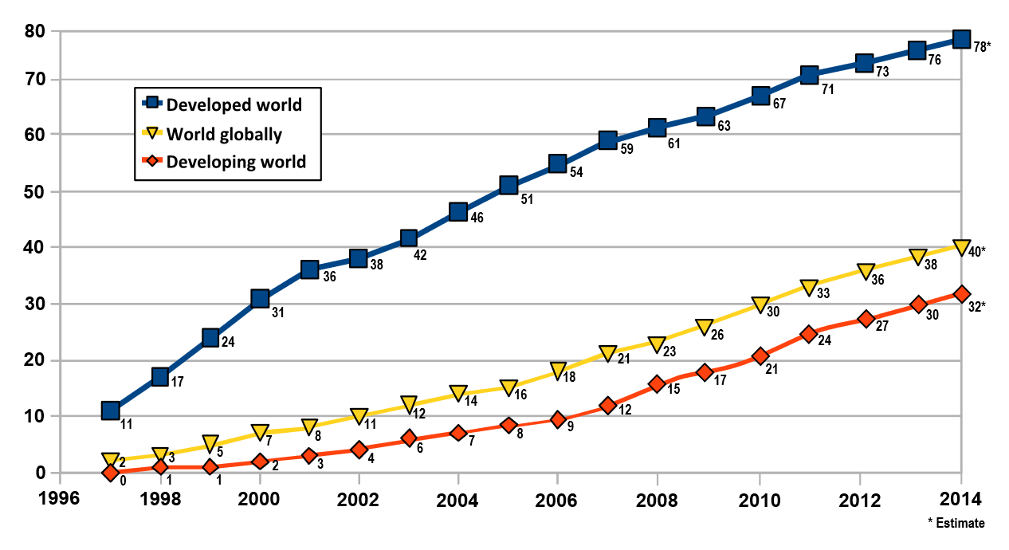
Economic Growth
Internet users per 100 inhabitants Source: International Telecommunications Union

Slide 8
Environmental Protection
Environmental Protection has become more important to governments and businesses over the last 20 years, leading to great improvements in the number of people willing to invest in green technologies such as solar and wind energy projects, smart grids with renewable energy sources, LED street lights, energy servers bulbs and energy efficient buildings.
IT changes human behaviors to that which positively impacts the environment. Achieving more with minimal environmental impact

Slide 9
Social Equality
The Social Equality and equity as pillars of sustainable development focus on the social well-being of people.
The growing gap between incomes of rich and poor is evident throughout the world with the incomes of the richer households increasing relative to the incomes of middle - or lower-class households.
Global inequality has been declining, but the world is still extremely unequal, with the richest 1% of the world’s population owning 40% of the world’s wealth and the poorest 50% owning around 1%

Slide 10
Sustainable Development Goals
At the United Nations Sustainable Development Summit on 25 September 2015, world leaders adopted the 2030 Agenda for Sustainable Development, which includes a set of 17 Sustainable Development Goals (SDGs) to end poverty, fight inequality and injustice, and tackle climate change by 2030

Slide 11










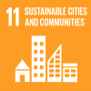







Sustainable Development Goals

Slide 12

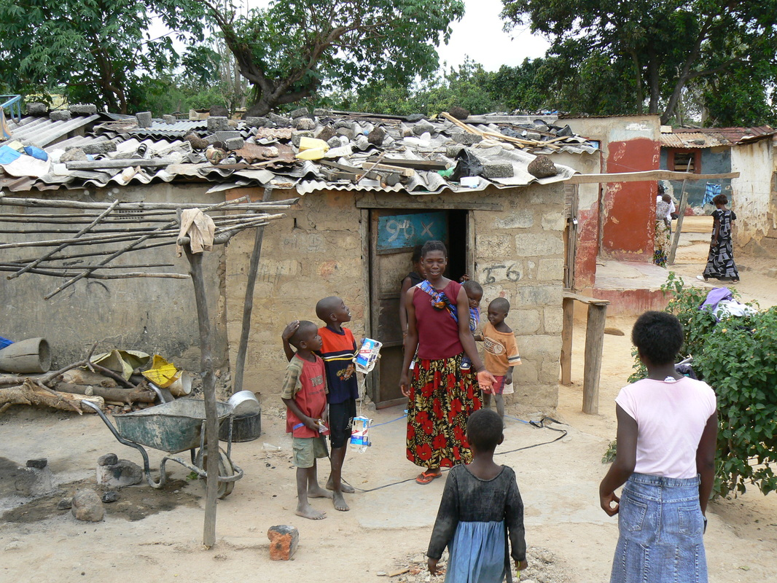
How IT Can Inspire SD – A Case for Zambia
This involves targeting those living in vulnerable situations, increasing access to basic resources and services, and supporting communities affected by conflict and climate-related disasters
Case for Zambia: IT can be harnessed to create jobs in a number of ways.
Expansion of communication facilities e.g. building fibre networks, local labour is employed.
Creation of apps that are relevant to the local environment. A lot of people have mobile phones hence there is an untapped industry for youth to be creative and earn a living
SDG 1: No poverty

Slide 13

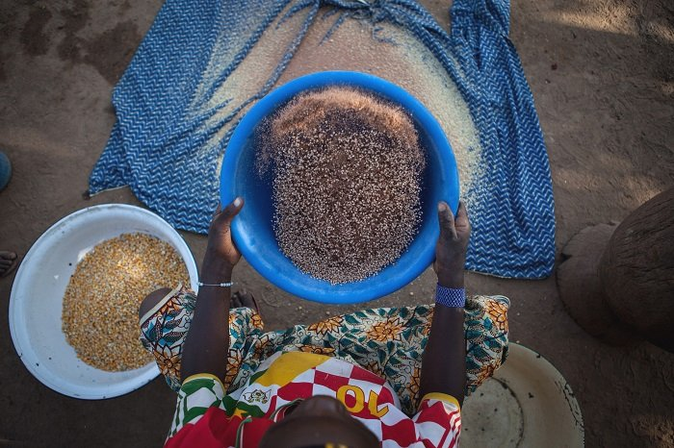
How IT Can Inspire SD – A Case for Zambia
This involves promoting sustainable agricultural practices: improving the livelihoods and capacities of small scale famers, allowing equal access to land, technology and markets. It also requires international cooperation to ensure investment in infrastructure and technology to improve agricultural productivity
Case for Zambia: IT can be used for research in agricultural practices and technology that can benefit the local farmers.
There are a number of agricultural research institutions and universities that can carry out this research and IT should be at the center of the collaboration and sharing of information to get the results that would benefit the nation in this aspect.
SDG 2: Zero hunger

Slide 14


How IT Can Inspire SD – A Case for Zambia
Aims to achieve universal health coverage, and provide access to safe and effective medicines and vaccines for all. Supporting research and development for vaccines is an essential part of this process as well as expanding access to affordable medicines
Case for Zambia: IT should be at the center of the research and information gathering for purposes of collaboration and coming up with solutions. We don’t always have to wait for the outside in order to provide a solution.
For example in in the Ebola outbreak that shook West Africa, a group of medical personal used a simple excel spreadsheet to map the infections and thereby were able to control movement of people and curb the spread of the disease.
E-medicine can now be easily achieved with the spread of fibre communication across the country. There is no need for patients to travel all the way to UTH before a preliminary diagnosis by an expert is carried out. We recently provided internet services to the just ended AFDB annual conference and the quality of live streaming was unrivalled to say the least.
SDG 3: Good health and well-being

Slide 15

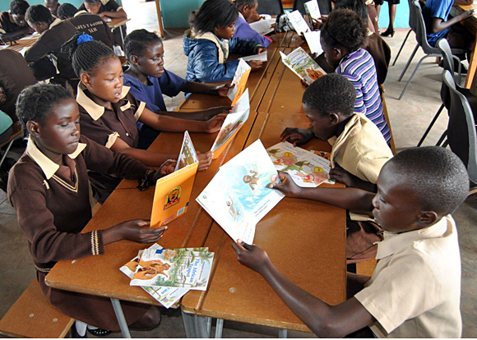
How IT Can Inspire SD – A Case for Zambia
This goal ensures that all girls and boys complete free primary and secondary schooling by 2030. It also aims to provide equal access to affordable vocational training, and to eliminate gender and wealth disparities with the aim of achieving universal access to a quality higher education
Case for Zambia: ICT is already being used to enhance the availability of education materials.
This can be taken further to provide virtual classrooms so a teacher in say Lusaka can teach a class in Mbala and the children will have access to experts in different vocations.
Urgent need to improve the quality of education
SDG 4: Quality education

Slide 16

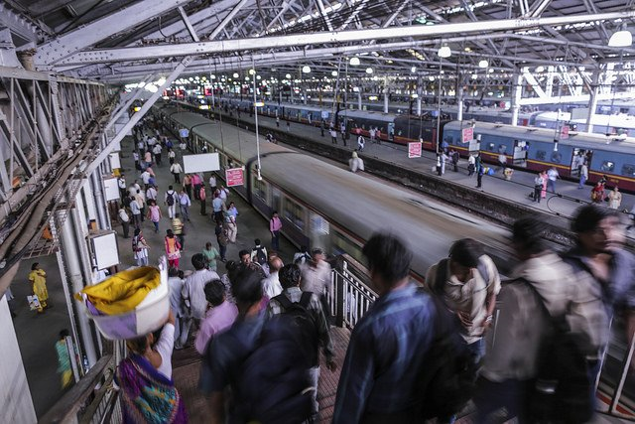
How IT Can Inspire SD – A Case for Zambia
More than 4 billion people still do not have access to the Internet, and 90 percent are from the developing world. Bridging this digital divide is crucial to ensure equal access to information and knowledge, and as a consequence foster innovation and entrepreneurship.
Case for Zambia: Internet penetration is still very low and this is being addressed though more can still be done.
As much as there is a mass of information currently available, most of it is not relevant hence rendering the internet a not so useful tool to some populations and cultures.
This also opens up to opportunities for local developers to provide platforms for development of and sharing of content that is relevant to the local population.
SDG 9: Industry, innovation, infrastructure

Slide 17

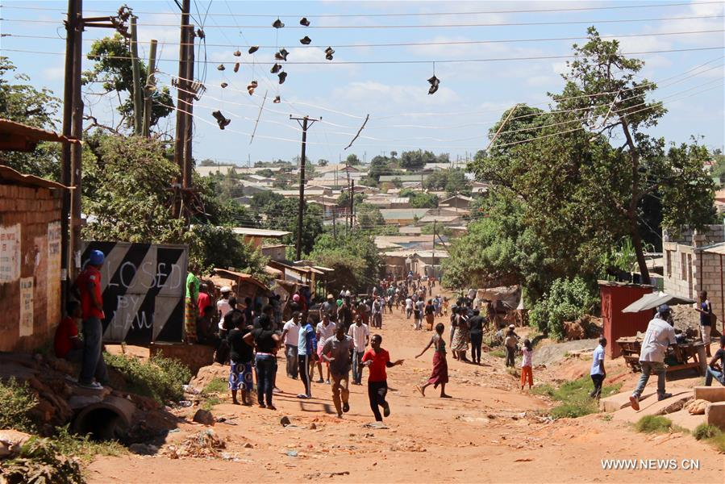
How IT Can Inspire SD – A Case for Zambia
Extreme poverty is often concentrated in urban spaces, and national and city governments struggle to accommodate the rising population in these areas. Making cities safe and sustainable means ensuring access to safe and affordable housing, and upgrading slum settlements. It also involves investment in public transport, creating green public spaces, and improving urban planning and management in a way that is both participatory and inclusive.
Case for Zambia: IT can help in the collection storing and access to data that is required for municipalities to assist in management and planning of various infrastructure.
At the moment even a city like Lusaka does not have a database that is easily accessible e.g. for fibre infrastructure to a point where various operators end up disrupting each other’s networks when carrying out works.
Security can be addressed with the installations of CCTV in strategic locations. This can also be used in the control of traffic, crowd control etc.
SDG 11: Sustainable cities and communities

Slide 18

How IT Can Inspire SD – A Case for Zambia
The world today is more interconnected than ever before. Improving access to technology and knowledge is an important way to share ideas and foster innovation. Coordinating policies to help developing countries manage their debt, as well as promoting investment for the least developed, is vital to achieve sustainable growth and development
Case for Zambia: use IT for close collaboration between the relevant stakeholders.
World is now a global village and no country can operate in isolation
Interconnected by ICT infrastructure
Fastest ICT speeds can easily be attained in developing world.
SDG 17: Partnerships for the goals

Slide 19
Recommended Way Forward
Develop sustainable Access Network ICT infrastructure in both urban and non-urban areas. In a coordinated way build or encourage private sector participation in the roll out of ICT infrastructure over which other dependence ICT services could be provided
Fast track the development of world class ICT human resource programs as this is the linchpin for ICT development. Zambia currently has a major shortfall in this critical skills. Develop an ICT society by including ICT in the education curriculum
Zambia should not be just a consumer of ICT goods and services but also a producer and developer of the technology and content
Promote intensive public ICT awareness activities at all levels of society
Need to have integrated ICT Systems to bring the needed efficiencies for social-economic benefits

